Slide 1
Capestone Final Project
By : Sanjit Bhagat

Slide 2
Jaipur has a good opportunity for business
Jaipur is the capital of India’s Rajasthan state. At the centre of its
stately street grid (notable in India) stands the opulent, colonnaded
City Palace complex. With gardens, courtyards and museums, part of it is
still a royal residence. As a capital city it has a good opportunity for
an individual/business to open the restaurant/ coffee shop/ cafe near
the city centre.
This project is focusing on, finding the places where a *restaurant/
coffee shop/ cafe* can be opened. The project will lead to the
destinations where there are *few or no restaurants* having the *optimal
distance* from the *city centre*.

Slide 3
The following is the procedure
We will require the process
Get all the picodes of Jaiupr city
Clean the data and will aquire almost all picodes near the location
Get the coordinates of pincodes using geopy
Use Foursquare to explore the needed venues with respect to all the locations we have
Apply k-means to get the clusters having less venues
Use Folium to plot the map wherever required

Slide 4
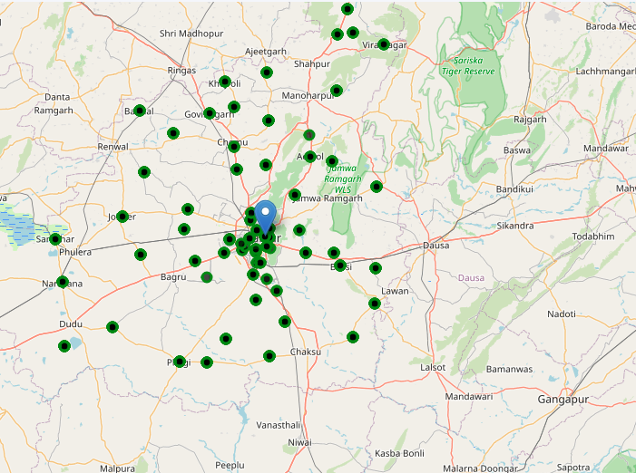
Locations from the city center

Slide 5
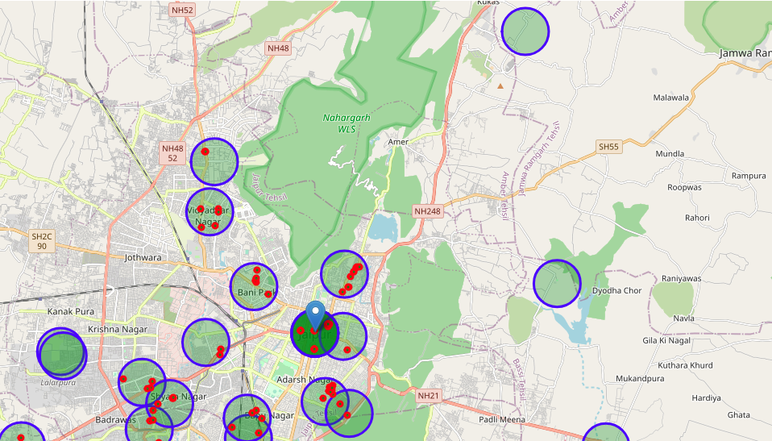
After filter
Circle denotes the area
Red dot denotes the no of venues

Slide 6
Addresses of centres of areas recommended for further analysis
Shiv Nagar, Vidyadhar Nagar, Jaipur Municipal Corporation, Jaipur Tehsil, Jaipur, Rajasthan, 302039, India
Tagore Nagar, Badrawas, Jaipur Municipal Corporation, Jaipur Tehsil, Jaipur, Rajasthan, 302021, India
Sanganer Tehsil, Jaipur, Rajasthan, 302022, India
TRatanpura, Bassi Tehsil, Jaipur, Rajasthan, 302031, India
Khoramina, Kukas, Amber Tehsil, Jaipur, Rajasthan, 302028, India
Durgapura, Bapu Nagar, Jaipur Municipal Corporation, Sanganer Tehsil, Jaipur, Rajasthan, 302015, India
Moti Doongri Road, Fateh Tibba, Adarsh Nagar, Jaipur Municipal Corporation, Jaipur Tehsil, Jaipur, Rajasthan, 302004, India

Slide 7
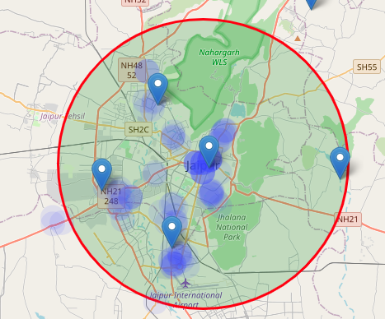
The final map

Slide 8
Conclusion
This concludes our analysis. We have created 15 addresses representing
centers of zones containing locations with low number of restaurants.
These seven locations have less then 7 restaurants in the corresponding
area, so it's good the observe these sites Although zones are shown on
map with a radius of ~1000 meters (green circles), their shape is
actually very irregular and their centers/addresses should be considered
only as a starting point for exploring area neighborhoods in search for
potential restaurant locations. Most of the zones are located in Jaipur,
which we have identified as interesting due to being popular with
tourists, fairly close to city center and well connected by public
transport.

Slide 9
Thank-you

